Slide 1
Lecture 10: Deep Sequence Modeling. Recurrent neural networks.

Slide 2
Predictive learning
Given an element predict nearby elements (e.g. next, previous, adjacent, etc.)
Does not require annotated data (“self-supervised”)
Usually considered as unsupervised, but often works much better than “plain” unsupervised
Particularly prominent in NLP, but now gaining popularity in many fields
Today’s focus: sequence modeling, sequence prediction

Slide 3
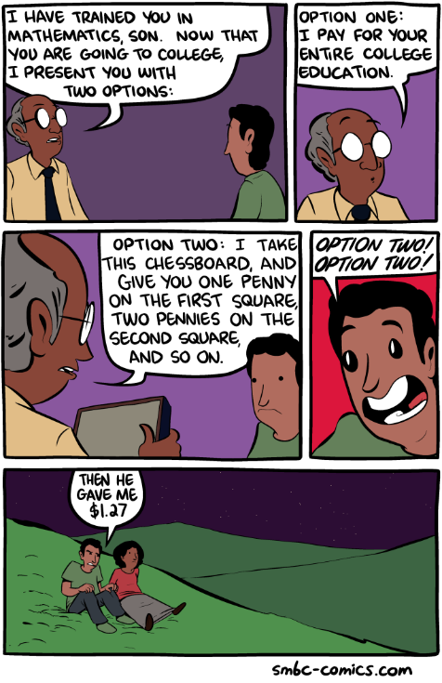
Predicting sequences matters
Applications:
Synthesis (text, speech, etc.)
Probabilistic modelling
Compression
smbc-comics.com

Slide 4

Training sequence prediction
A cat sat on a ma?
Inherently probabilistic: need to predict probabilities over lexicon

Slide 5
Training sequence prediction
A cat sat on a ma?
Predominantly maximum likelihood learning:
Many models goes back fixed number of steps:
Temporal window

Slide 6
Fixed window/order architectures
N-grams (with smoothing)
CNNs (aka TDNNs)
Any probabilistic classifier (e.g. decision forest, etc.)
NB: using padding for the special symbol (UNK) we can train model for shorter sequences

Slide 7
Probabilistic modeling of long sequences
Assume given

Slide 8
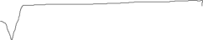
Assessing a probabilistic model
Train
Evaluate on a hold-out set
Common measure (perplexity):

Slide 9
ML sequence generation
Task: draw a sample sequence with high-probability
Option 1: synthesize one-by-one greedily, picking the symbol with highest probability
Option 2: beam search

Slide 10
Beam search
The c??????
The ca?????
The cat????
The cat????
The cap????
The cam????
The co?????
The cor????
The cap????
The col????
The cow????
The ch?????
The cha????
The cor????
The cho????
The chi????

Slide 11
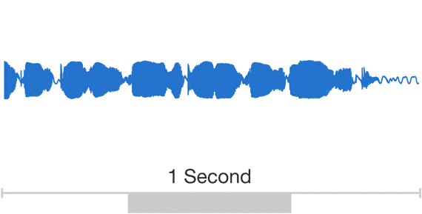
WaveNet
Generating raw waveforms at 16 kHz (very uncommon)

Slide 12
WaveNet: dilated ConvNet
Repeated pattern of dilations: 1,2,…512,1,2,…512,…
Gated (bilinear) non-linearity:
There are also skip connections
[van der Oord et al, 2016]

Slide 13

WaveNet: dilated ConvNet
[van der Oord et al, 2016]

Slide 14
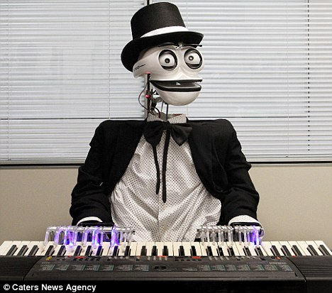

WaveNet: piano results
Trained on 60 hours of piano (from YouTube)
[van der Oord et al, 2016]

Slide 15
WaveNet: speech results
Trained on 24.6 hours of speech
Receptive field is 0.24 seconds
Conditioned on the speaker ID
[van der Oord et al, 2016]

Slide 16
Picking a probabilistic model
N-grams
CNNs (aka TDNNs)
Any probabilistic classifier
Common problem: picking size of the window
Avoiding overfitting
To work on instances of different length
To track long-range behavior

Slide 17
Recurrent neural network (RNN)
*
φ ○ *
softmax
φ ○ *
NB: I omit bias terms but they can be useful!

Slide 18
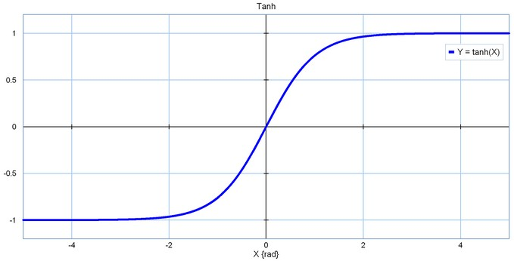
Most popular non-linearity for RNNs

Slide 19
Unwrapping RNN
φ ○ *
φ ○ *
φ ○ *
φ ○ *
φ ○ *
φ ○ *
φ ○ *
φ ○ *
φ ○ *
*
*
*
*

Slide 20
Training RNN
φ ○ *
φ ○ *
φ ○ *
φ ○ *
φ ○ *
φ ○ *
φ ○ *
φ ○ *
φ ○ *
*
*
*
*

Slide 21
Training RNN

Slide 22
Training RNN
φ ○ *
φ ○ *
φ ○ *
φ ○ *
φ ○ *
φ ○ *
φ ○ *
φ ○ *
*
*
*
*

Slide 23
Training RNN
φ ○ *
φ ○ *
φ ○ *
φ ○ *
φ ○ *
φ ○ *
φ ○ *
φ ○ *
*
*
*
*
In practice: unwrapping for a finite number of time-steps (or training on bounded length sequences)

Slide 24
Training RNN

Slide 25
Challenges with training RNN
vanishing gradient:
network forgets information
exploding gradient: learning quickly “explodes”

Slide 26
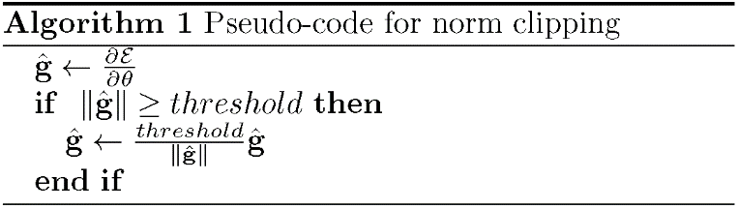
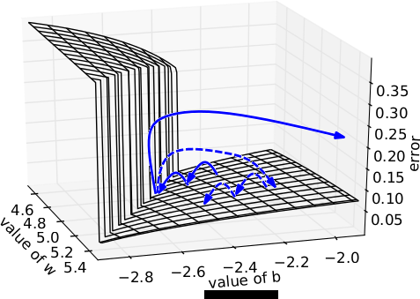
Gradient clipping
Simple trick handles gradient explosion (provided that the “valley” is wide)
[Pascanu et al. 2013]

Slide 27
Handling vanishing gradient
Even if the gradient does not vanish totally, the information stored in low-energy subspaces will not be propagated
Idea: we need mechanism to ensure long-term propagation.

Slide 28
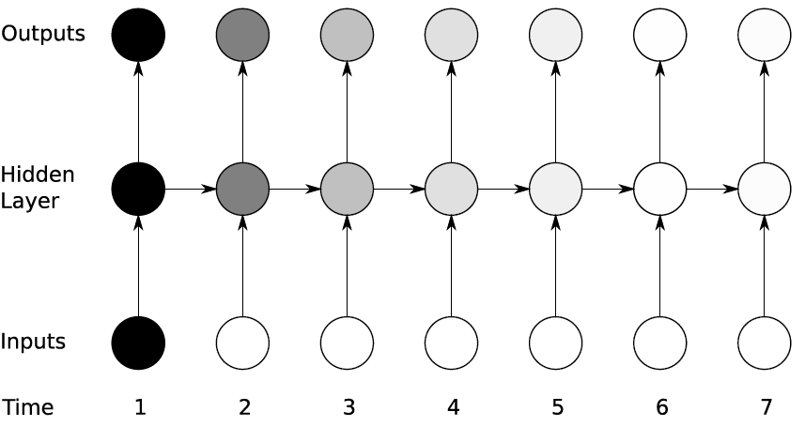
Vanishing gradient visualization
The influence of an input unit quickly vanishes with time
[Graves 12]

Slide 29
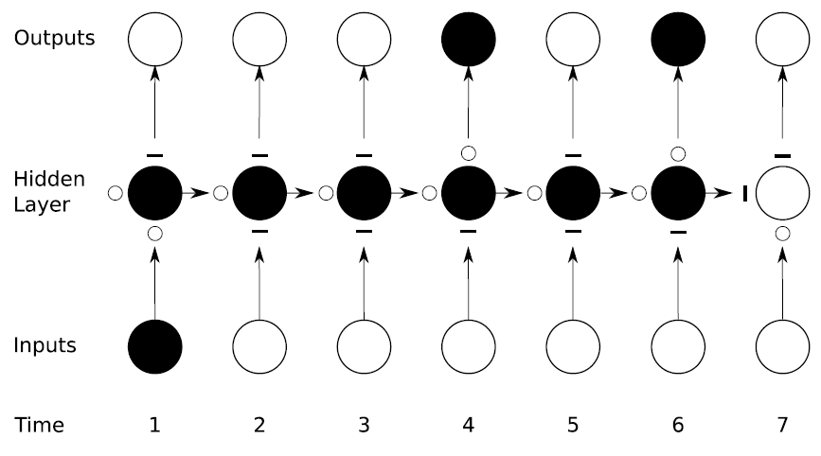
Long Short-term Memory
= gate open
= gate closed
[Graves 12]
[Hochreiter & Schmidhuber 97]

Slide 30
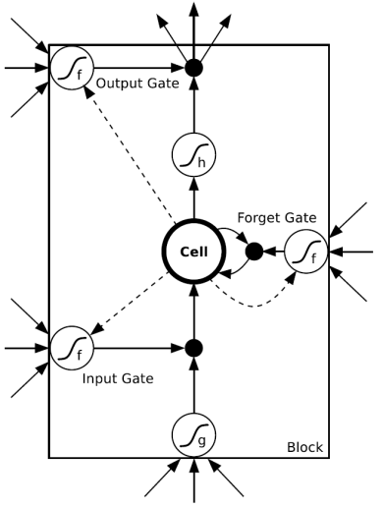
Long Short-term Memory
Gate activations are trainable functions of x and h
[Graves 12]
[Hochreiter & Schmidhuber 97]
Plain RNN
LSTM RNN

Slide 31
Long Short-term Memory: gate activations
[Graves 12]
[Hochreiter & Schmidhuber 97]
LSTM RNN

Slide 32
Long Short-term Memory: cell update
[Graves 12]
[Hochreiter & Schmidhuber 97]
LSTM RNN

Slide 33
Long Short-term Memory
= gate open
= gate closed
[Graves 12]
[Hochreiter & Schmidhuber 97]

Slide 34
Multi-layer RNNs

Slide 35
Recap: RNN-LSTM as a probabilistic model

Slide 36
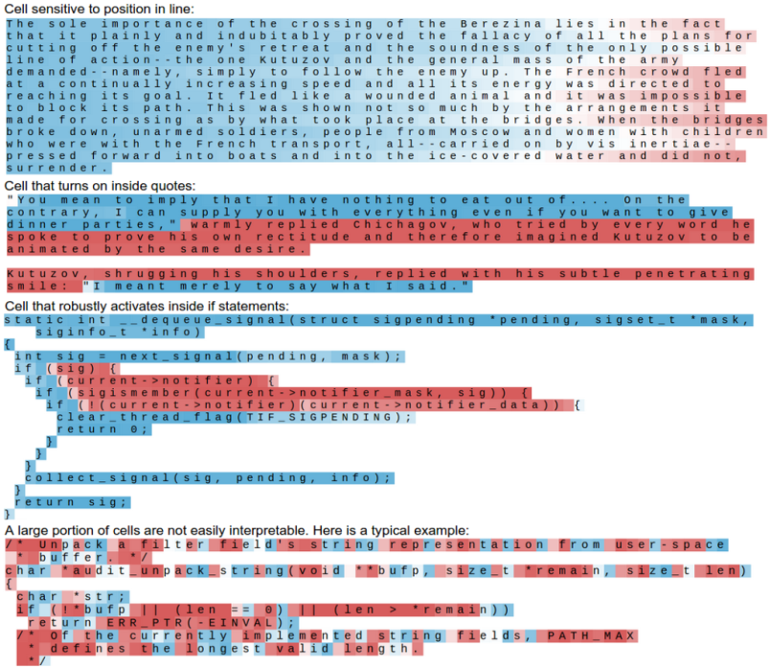
Interpretable LSTM Cells
[Karpathy et al. ICLR16]

Slide 37
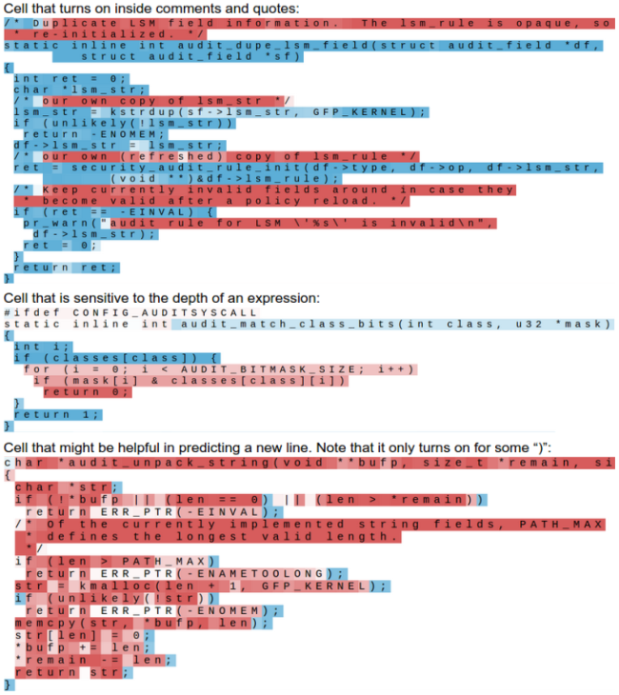
Interpretable LSTM Cells
[Karpathy et al. ICLR16]

Slide 38
Interpretable LSTM Cells
[Karpathy et al. ICLR16]

Slide 39
Non-interpretable LSTM Cells
[Karpathy et al. ICLR16]

Slide 40
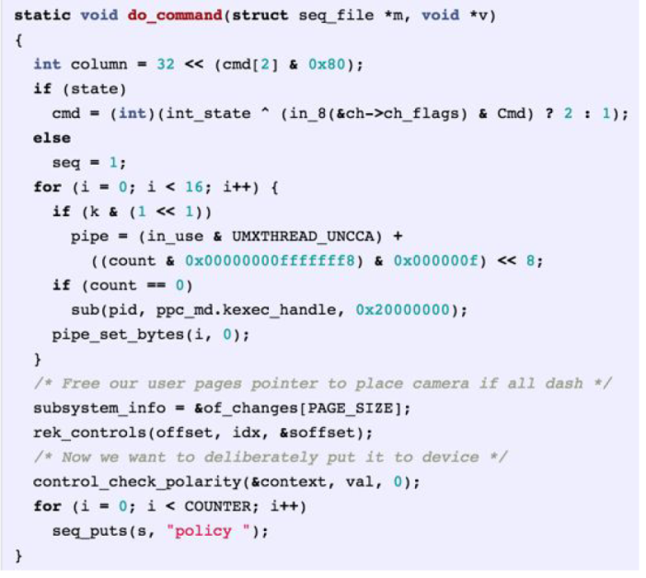
Computer generated “Linux kernel code”
© Andrej Karpathy:
More fun: 1) http://karpathy.github.io/2015/05/21/rnn-effectiveness/ 2) your assignment

Slide 41
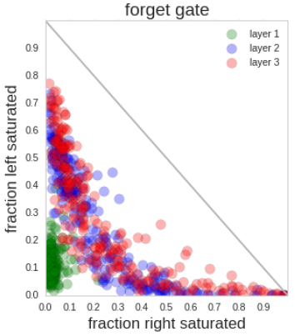
Interpretable LSTM Cells
<0.1
(forget info)
[Karpathy et al. ICLR16]
>0.9 (keep info)

Slide 42
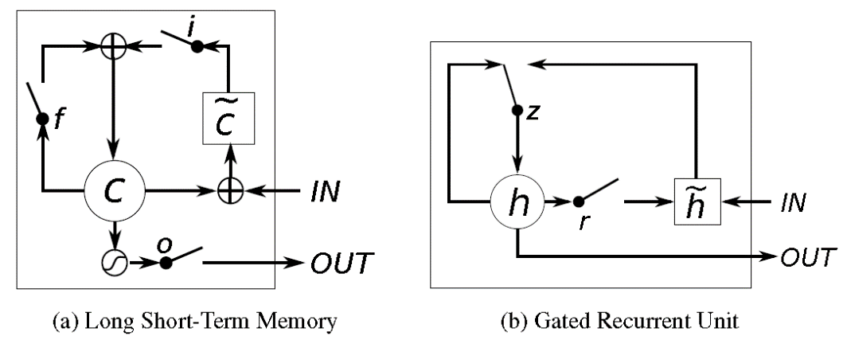
Gated Recurrent Units (GRU)
[Cho et al. 14]
[Chung et al. 14]

Slide 43
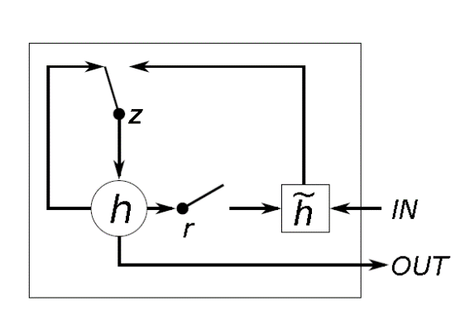
Gated Recurrent Units (GRU)
UPDATE
RESET
[Cho et al. 14]
[Chung et al. 14]

Slide 44
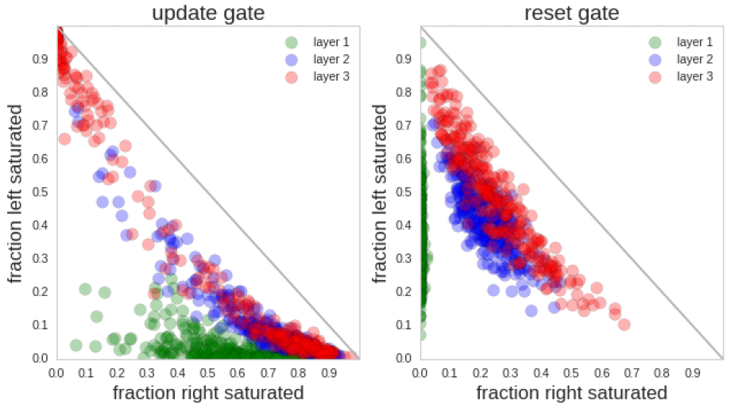
GRU gate statistics
[Karpathy et al. ICLR16]

Slide 45
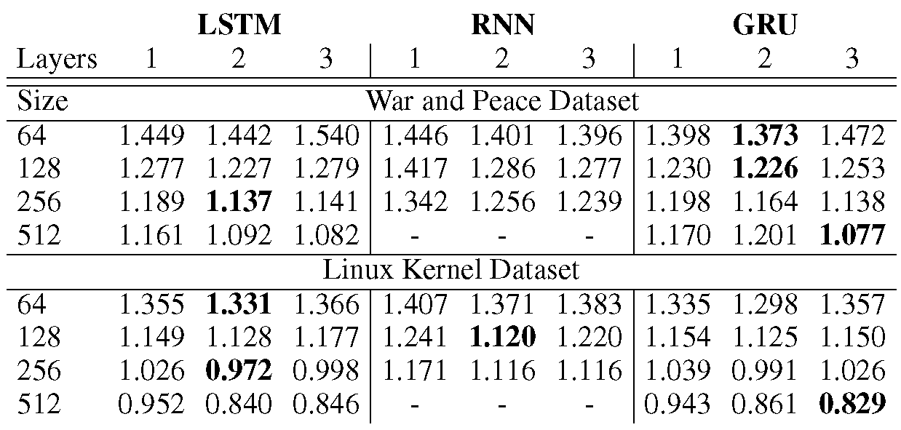
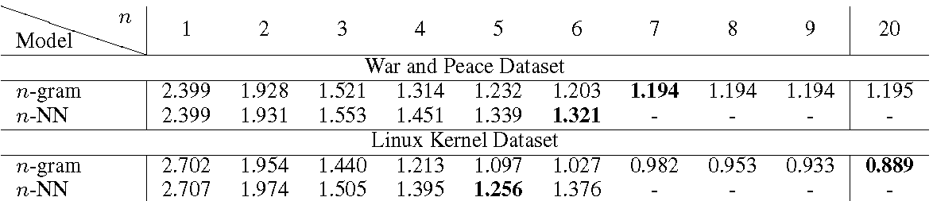
Plain vs LSTM vs GRU
Success at predicting next characters in the test sequence (cross-entropy loss) [Karpathy et al. ICLR16]:

Slide 46
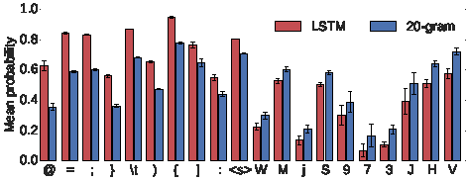
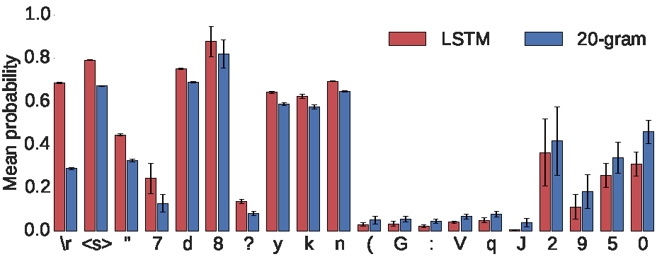
RNN success cases
Success at predicting next characters in the test sequence (cross-entropy loss) [Karpathy et al. ICLR16]:
Linux kernel:
War and peace:

Slide 47
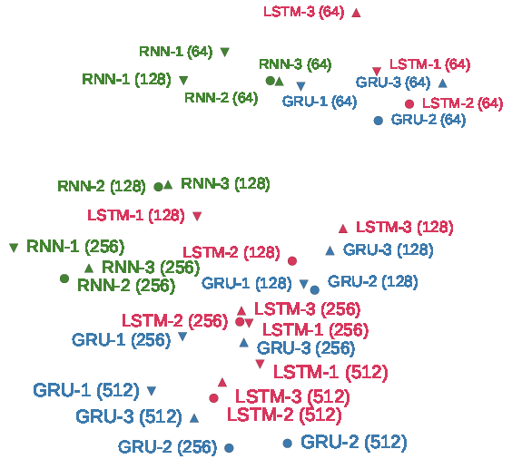
Plain vs LSTM vs GRU
Model similarity (t-SNE embedding of character probabilities):
[Karpathy et al. ICLR16]

Slide 48
Structurally constrained RN
[Mikolov et al. 15]
Notes:
Alpha = 0.95

Slide 49
Structurally constrained RN
Penn-bank word prediction
For the other dataset (Text8), LSTM is better
[Mikolov et al. 15]

Slide 50
Recap and outlook
Sequence prediction
Recurrent nets are SOA in wide variety of domains (NLP, speech/signal, bioinformatics)
Gating in RNN makes its memory longer
Sequence prediction extends to other tasks (fixed->seq, seq->fixed, seq->seq, fixed->fixed) – next lecture

Slide 51
Bibliography
Elman, Jeffrey L. Finding structure in time. Cognitive science, 14(2):179–211, 1990.
A. Karpathy
The Unreasonable Effectiveness of Recurrent Neural Networks
http://karpathy.github.io/2015/05/21/rnn-effectiveness/
Razvan Pascanu, Tomas Mikolov, Yoshua Bengio:
On the difficulty of training recurrent neural networks. ICML (3) 2013: 1310-1318
A. Graves. Supervised Sequence Labelling with Recurrent Neural Networks. Textbook, Studies in Computational Intelligence, Springer, 2012
Sepp Hochreiter, Jürgen Schmidhuber:
Long Short-Term Memory. Neural Computation 9(8): 1735-1780 (1997)

Slide 52
Bibliography
Kyunghyun Cho, Bart van Merrienboer, Çaglar Gülçehre, Dzmitry Bahdanau, Fethi Bougares, Holger Schwenk, Yoshua Bengio: Learning Phrase Representations using RNN Encoder-Decoder for Statistical Machine Translation. EMNLP 2014: 1724-1734
Junyoung Chung, Çaglar Gülçehre, KyungHyun Cho, Yoshua Bengio:
Empirical Evaluation of Gated Recurrent Neural Networks on Sequence Modeling. CoRRabs/1412.3555 (2014)
Andrej Karpathy, Justin Johnson, Fei-Fei Li:
Visualizing and Understanding Recurrent Networks. ICLR 2016
Mikolov, T., Joulin, A., Chopra, S., Mathieu, M., & Ranzato, M. A. (2014). Learning longer memory in recurrent neural networks. arXiv preprint arXiv:1412.7753.

